Slide 1


JavaScript
Discover the JavaScript Language
Notes:
© SUPINFO International University - http://www.supinfo.com
SUPINFO vous permet de partager ce document
Vous êtes libre de :
Partager — reproduire, distribuer et communiquer ce document Remixer — modifier ce document
A condition de respecter les règles suivantes :
Indication obligatoire de la paternité — Vous devez obligatoirement préciser l’origine « SUPINFO » du document au début de celui-ci de la même manière qu’indiqué par SUPINFO International University – Notamment en laissant obligatoirement la première et la dernière page du document, mais pas d'une manière qui suggérerait que SUPINFO International University vous soutiennent ou approuvent votre utilisation du document, surtout si vous le modifiez. Dans ce dernier cas, il vous faudra obligatoirement supprimer le texte « SUPINFO Official Document » en tête de page et préciser notamment la page indiquant votre identité et les modifications principales apportées.
En dehors de ces dispositions, aucune autre modification de la première et de la dernière page du document n’est autorisée.
NOTE IMPORTANTE : Ce document est mis à disposition selon le contrat CC-BY-NC-SA Creative Commons disponible en ligne http://creativecommons.org/licenses ou par courrier postal à Creative Commons, 171 Second Street, Suite 300, San Francisco, California 94105, USA modifié en ce sens que la première et la dernière page du document ne peuvent être supprimées en cas de reproduction, distribution, communication ou modification. Vous pouvez donc reproduire, remixer, arranger et adapter ce document à des fins non commerciales tant que vous respectez les règles de paternité et que les nouveaux documents sont protégés selon des termes identiques. Les autorisations au-delà du champ de cette licence peuvent être obtenues à support@supinfo.com.
© SUPINFO International University – EDUCINVEST - Rue Ducale, 29 - 1000 Brussels Belgium . www.supinfo.com

Slide 2

JavaScript
Course objectives
By completing this course, you will be able to:
Explain origins of JavaScript
Describe how it works
Explain its utility
Develop basic JavaScript procedures
Manipulate the DOM with JavaScript

Slide 3


JavaScript
Course plan
Presentation
Basics notions
Functions & Scope
Events
DOM Interactions
Object Modeling

Slide 4

Introduction
Discover JavaScript language

Slide 5

Introduction
Presentation
JavaScript is a scripting language
Design by Brendan Eich (Netscape) in 1995
Inspired by many languages, including Java and Python

Slide 6
Introduction
Presentation
At first, server side language called LiveScript
Then, client side version called JavaScript
Partnership between Sun Microsystems and Netscape about the name
"JavaScript” was a trademark of Sun Microsystems and now Oracle Corporation

Slide 7
Introduction
Presentation
Client side → Interpreted by web browser
Different from PHP
Complementary to HTML and CSS
Add dynamism!
User Interactions
Animations
Navigation Help

Slide 8
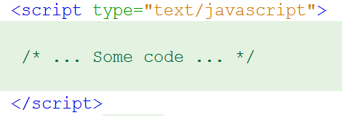

Introduction
Presentation
As CSS, JavaScript code can be defined in:
HTML code
a separate script file (.js)

Slide 9
Introduction
Presentation
Based on events:
onload
onfocus
onclick
ondblclick
Associated to DOM objects:
window, document, forms, ...
onabort
onerror
onmouseover
….
Notes:
DOM = Document Object Model
In two words, the DOM is a representation of your web page.
A longer explanation:
« The Document Object Model (DOM) is an application programming interface (API) for valid HTML and well-formed XML documents. It defines the logical structure of documents and the way a document is accessed and manipulated. In the DOM specification, the term "document" is used in the broad sense - increasingly, XML is being used as a way of representing many different kinds of information that may be stored in diverse systems, and much of this would traditionally be seen as data rather than as documents. Nevertheless, XML presents this data as documents, and the DOM may be used to manage this data.”
https://www.w3.org/TR/DOM-Level-2-Core/introduction.html

Slide 10
Introduction
Presentation
Not a classical OOP language
Prototype-based
No real concept of class
"Pseudo-classes" can be written like collections of key/value pairs
Includes most of class-based OOP features
Notes:
OOP = Object Oriented Programing

Slide 11
History
Introduction
First release of Netscape
JavaScript creation
Release of Netscape2 with JavaScript
ECMA produced the ECMAScript
Release of IE3 with JScript
(MS implem. of JS)
1994
1995
1996

Slide 12
History
Introduction
Release of JavaScript 1.1 and Netscape 3
Release of JavaScript 1.2
Release of Netscape 4
Release of Internet Explorer 5 with JavaScript 1.5
Appearance of the term: DHTML
1996
1997
1999

Slide 13
History
Introduction
JavaScript 1.5
First Mozilla release
JavaScript 1.6
JavaScript 1.8
JavaScript 1.7
JavaScript 1.8.5
2000
2002
2005
2006
2008
2010

Slide 14



Libraries
Introduction
Many libraries :
jQuery
Ext JS
Prototype
Dojo
Etc…

Slide 15

Community
Introduction

Slide 16
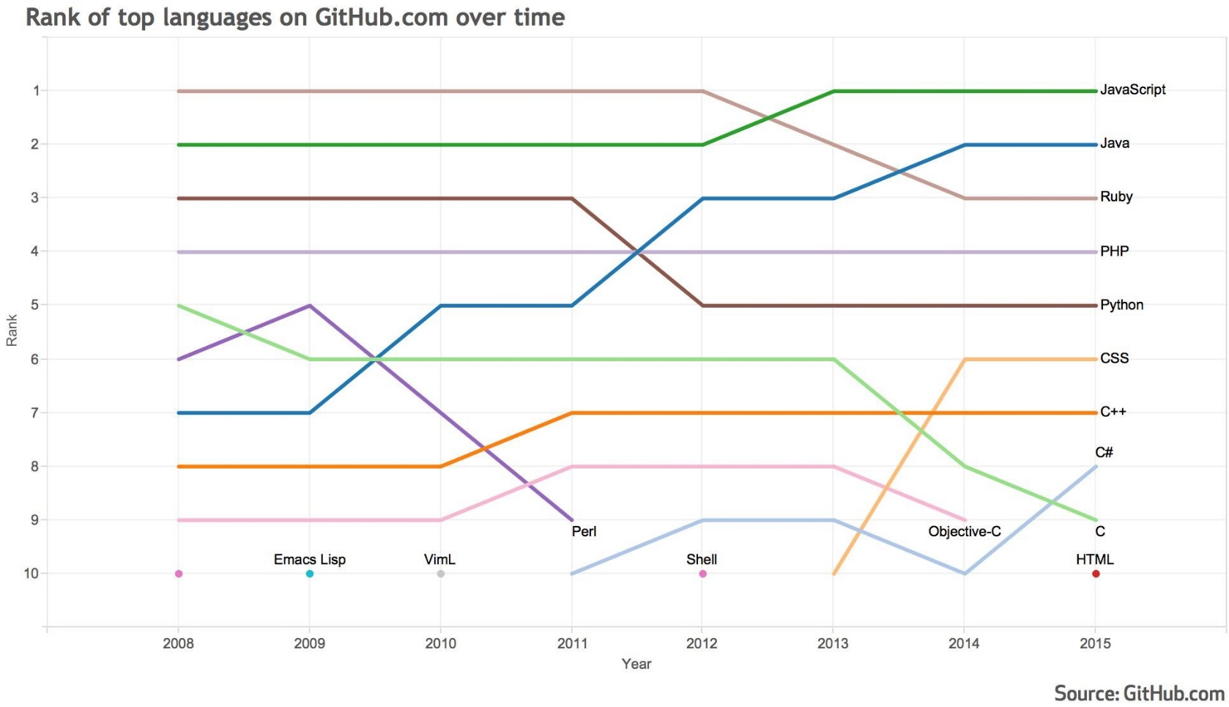
Community
Introduction
Notes:
https://github.com/blog/2047-language-trends-on-github

Slide 17


Questions ?

Slide 18

Basic notions
Discover JavaScript language

Slide 19

Hello World!
Basic notions
Hello world example:
<!DOCTYPE html>
<html>
<head>
<title>Hello World!</title>
</head>
<body>
<script type="text/javascript">
alert('Hello world!');
</script>
</body>
</html>

Slide 20
Implementation of JavaScript code
Basic notions
Two places to declare JavaScript code:
In HTML file directly between <script> markers:
In an external script file (better most of the time):
<script type="text/javascript"> var name = "Grima"; </script>
<script type="text/javascript" src="script.js"></script>

Slide 21
Syntax rules and basics
Basic notions
An instruction ends up properly with a semicolon:
Possible to put on the same line several instructions
<script type="text/javascript">
Instruction_1;
Instruction_2; Instruction_3;
</script>

Slide 22
Syntax rules and basics
Basic notions
We create a single line comment with //, multi-lines between /* and */
<script type="text/javascript">
// Single line comment
/* Multi
line
comment */
</script>

Slide 23
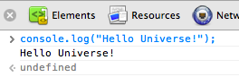
Syntax rules and basics
Basic notions
To display text on the console:
console.log()
<script type="text/javascript">
// Displays Hello Universe!
console.log("Hello Universe!");
</script>
Notes:
Note that depending on the browser, you can use other functions: console.warn, console.err, etc.

Slide 24
Syntax rules and basics
Basic notions
To display text on a web page:
document.write()
<script type="text/javascript">
// Add « Hello World! » inside the page
document.write("Hello World!");
</script>

Slide 25
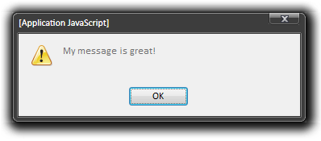
Syntax rules and basics
Basic notions
To display a message through a dialog box:
window.alert(message)
window.alert("My message is great!");
// Also works
alert("My message is great!");
Notes:
https://developer.mozilla.org/en/nsIPromptService

Slide 26
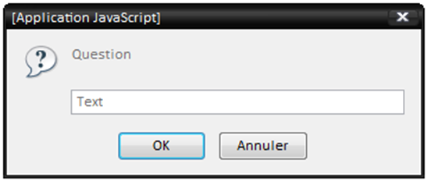
Syntax rules and basics
Basic notions
To get a value with a prompting box:
window.prompt(text, default_value)
var returnValue = window.prompt("Question", "Text");
// Also works
returnValue = prompt("Question", "Text");
Notes:
https://developer.mozilla.org/en/nsIPromptService

Slide 27

Variables
Basic notions
Case sensitive:
myvariable ≠ myVariable
We assign a value to a variable by setting its name on the left of the assignment operator
( = ), and the value on the right

Slide 28
Variables
Basic notions
Explicit declaration with var keyword
A variable's name:
Can not begin by a number
Must contain only alphanumerical characters.
Can not be a reserved word (var, for…)
<script type="text/javascript">
var name = "Estelle";
</script>

Slide 29
Variables
Basic notions
Implicit declaration without var
<script type="text/javascript">
name = "Doug";
</script>

Slide 30
Variables
Basic notions
Concatenation: Combine string value(s) with other types
Operator +
var max_age = 18;
var message = "Not allowed under " + max_age + " years old";

Slide 31
Variables
Basic notions
Weak typing
Type of a variable defines format of its content
Obtain type of a variable: typeof
var myVar1 = "I am a string !";
var myVar2 = "Am I really a string ?";
myVar2 = 100;
document.write(typeof myVar1); // Will display "string"
document.write(typeof myVar2); // Will display "number"
Notes:
C use strong typing !

Slide 32
Variables cast
Basic notions
parseXXX: Parse from one type to another
parseInt
parseFloat
var number = "11";
var parsed = parseInt(number);
document.write(parsed + 1); // Will display 12
document.write(number + 1); // Will display 111
Notes:
Note, if a parseInt fails you get a NaN, which means Not a Number.
You can target these with the isNaN function.

Slide 33

Operators
Basic notions
Mathematic operators:
Symbol | Example | Explanation
= | var salary = 2800; | Affectation
+ | salary = salary + 2800 | Operation or Concatenation
- | salary = salary – 2800 | Substraction
* | salary = salary * 2800 | Multiplication
/ | salary = salary / 2800 | Division
% | salary = salary % 2800 | Modulo

Slide 34
Operators
Basic notions
Comparison operators:
(given salary = 2800)
Symbol | Example | Returns | Explanation
== | salary == 2800 salary == "2800" | true true | Equals
=== | salary === "2800" salary === 2800 | false true | Exactly equals (value and type)
!= | salary != 2800 | false | Not equals
!== | salary !== "2800" | true | Not exactly equals (value and type)

Slide 35
Operators
Basic notions
Comparison operators:
(given salary = 2800)
Symbol | Example | Returns | Explanation
> | salary > 2800 | false | Greater than
>= | salary >= 2800 | true | Greater than or equals
<= | salary <= 2800 | true | Lower than or equals
< | salary < 2800 | false | Lower than

Slide 36
Operators
Basic notions
Logic operators:
Symbol | Example | Explanation
&& | age == 18 && salary > 2800 | AND
|| | age == 18 || salary > 2800 | OR
^ | age == 18 ^ salary > 2800 | Exclusive OR
>> | salary >> age | Bitwise shift right
<< | salary << age | Bitwise shift left

Slide 37
Operators
Basic notions
Misc operators:
Symbol | Example | Explanation
+= | age += 18; | Addition (number) or concatenation (string)
new | var array = new Array(); | Object instanciation
delete | delete array; | Object destruction

Slide 38
Conditional statements
Basic notions
Conditional test: if … else if … else
if( expression1 ) {
// If "expression1" is evaluated to true, then this
// block is executed
} else if ( expression2 ) {
// Otherwise, if "expression2" is evaluated to true,
// this block is executed
} else {
// Otherwise, this code block is executed
}

Slide 39
Conditional statements
Basic notions
Case test: switch
switch(myVar) {
case "case1":
// if(myVar === "case1")
break;
case "case2":
// if(myVar === "case2")
break;
default:
// else - Default code to execute
break;
}

Slide 40
Arrays
Basic notions
Contain several data sequences
Many ways to create an array:
By creating an Array object
By using square-brackets [] (adviced)
Support all JavaScript data types

Slide 41
Arrays
Basic notions
Creation of Arrays
var fruitBasket1 = new Array("Apples", "Bananas", "Pears");
var fruitBasket2 = [ "Oranges", "Bananas", "Strawberries"];
var fruitBasket3 = [];
var apple = fruitBasket1[0];
fruitBasket3.push(apple);

Slide 42
Loops
Basic notions
Conditional loop: while
// It loops 40 times
var myVariable = 40;
while( myVariable > 0 ) {
myVariable = myVariable – 1;
}

Slide 43
Loops
Basic notions
Conditional loop: do … while
Same as while
First test after the first execution of loop’s block
var myVariable = 0;
// Loop will execute once even if the test returns false
do {
myVariable -= 1;
} while (myVariable > 0);

Slide 44
Loops
Basic notions
Iterative loop: for
Specify (or not):
Initial state
Iteration condition
Iteration instruction
var a;
for (a = 0; a < 100; a += 1){
// Loop will display Blabla 100 times.
document.write("<p>Blabla</p>");
}

Slide 45
Questions ?

Slide 46

Exercise (1/3)
Basic notions
You’re going to design your first JavaScript app:
A Guess the Number Game!
Initialize a variable named numberToFind with a random number between 0 and 100*
Initialize another variable named remainingAttempts with the integer value 7
Notes:
Use Math.random(); to create a random number:
Var numberToFind = Math.floor(Math.random() * 100) + 1;
See more here: https://developer.mozilla.org/en-US/docs/Web/JavaScript/Reference/Global_Objects/Math/random

Slide 47
Exercise (2/3)
Basic notions
Until the user doesn’t find the numberToFind value and has remaining attempt, ask him to choose a number
If the number is the numberToFind value
Display a popup to the user to notify him he won
If the number is not the numberToFind value
Display a popup to the user to notify him if the number to find is greater or not

Slide 48
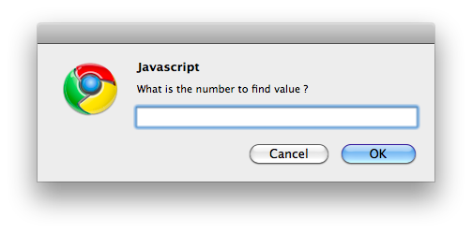
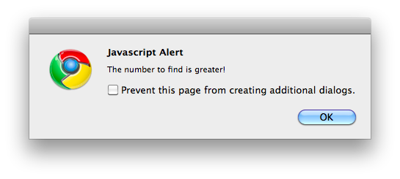
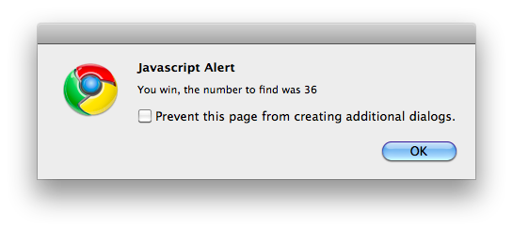
Exercise (3/3)
Basic notions

Slide 49

Functions & scope
Discover JavaScript language

Slide 50
Functions
Functions & Scope
Instruction unit
Declared with function keyword
Can take values or references called arguments
function myFunction(myParam1, myParam2) {
// Some code to execute
}

Slide 51
Functions
Functions & Scope
Called with its name followed by brackets:
functionName();
functionName(arguments);
Can send back a value with return keyword
Returned value can be use by the caller

Slide 52
Functions
Functions & Scope
Example:
function howOld(year){
var currentYear = new Date().getFullYear();
return currentYear - year;
}
// someValue will contain 22 (if current year is 2012)
var someValue = howOld(1990);
// Will display Bryan is 42 years old (if 2012)
console.log("Bryan is " + howOld(1970) + " years old");

Slide 53
Variable scope
Functions & Scope
Local:
Reachable only in the function where it's defined
Global:
Reachable in the whole document
function = scope
Explicit declaration inside function = local variable
Implicit declaration = global variable

Slide 54
Variable scope
Functions & Scope
Variables declared with var keyword inside a function are local variables of the function
Otherwise, without var keyword, they are considered as global variables
Declared variable outside function are also global variables

Slide 55
var myVar = "I am global\n";
function writeGlobal(){
console.log(myVar);
}
function setGlobal_writeLocal(newValue){
myVar = newValue;
var myVar = "I am local\n";
console.log(myVar);
}
writeGlobal();
setGlobal_writeLocal("I am still global\n");
writeGlobal();
// What displays the console ?
Quizz

Slide 56
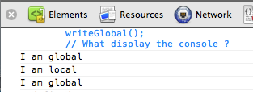
Variable scope
Functions & Scope
Be careful:
Variable declarations with var are always interpreted before the function execution

Slide 57
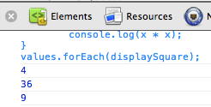
Function Expressions
Functions & Scope
JavaScript supports also function expressions
Functions with or without name (anonymous)
Can be used to contain functionality for short-term use
var values = [2, 6, 3];
var displaySquare = function(x) {
console.log(x * x);
}
values.forEach(displaySquare);

Slide 58
Functional
Functions & Scope
JavaScript is also a functional language !
First-class functions:
Can be assigned to variables or stored in data structures
Can be passed as arguments to other functions
Can be returned as the values from other functions

Slide 59
Pass a function as parameter – Example
Functions and Scope
Execute an operation once per array element:
The current element is represented by the param of the anonymous function
var myArray = ["Apple", "Strawberry"];
myArray.forEach( function(element) {
console.log(element + "/");
});
Notes:
We’ll see more about anonymous functions later…

Slide 60
Fn expression VS Fn declaration
Functions & Scope
Function declarations are evaluated before any instructions in the same context
Function expressions are evaluated after all the instructions preceding it

Slide 61
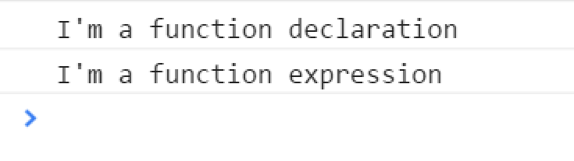
Example
Functions & Scope
function declaration() {
console.log("I'm a function declaration");
}
var expression = function() {
console.log("I'm a function expression");
}
declaration();
expression();

Slide 62
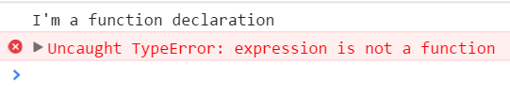
Example
Functions & Scope
declaration();
expression();
function declaration() {
console.log("I'm a function declaration");
}
var expression = function() {
console.log("I'm a function expression");
}

Slide 63
Questions ?

Slide 64

DoM interactions
Discover JavaScript language

Slide 65
Introduction
DOM
Document Object Model
W3C Standard
Whole of standardized objects for HTML
Standardized tools to access and manipulate HTML documents
Independent of the language or the platform

Slide 66
Introduction
DOM
Simplified arborescence:
window
document
html
body
form
input
img

Slide 67
Access Elements
DOM
Access to all the structure of an HTML page
We will be able to dynamically:
Access HTML elements
Access, Modify and delete attributes and values
Create, modify and delete elements
Organize elements into a hierarchy

Slide 68
Access Elements
DOM
Access a single element by a CSS selector:
Access an element list by a CSS selector:
Return a JavaScript array containing all homonyms
document.querySelector("#myElement");
document.querySelectorAll("p");

Slide 69
Access Elements
DOM
Access elements by their tag name:
Return a JavaScript array containing all elements with the specified tag
document.getElementsByTagName(tagName);

Slide 70
Access Elements
DOM
Example:
<img id="img1" name="theImage" src="test.png" />
<script type="text/javascript">
var img = document.querySelector("#img1");
var elements = document.getElementsByName("theImage");
console.log(elements[0] === img); // true
elements = document.querySelectorAll("img");
console.log(elements[0] === img); // true
</script>

Slide 71
Access Elements
DOM
Access to all child nodes of an element:
Access to the parent node:
element.childNodes;
element.parentNode;

Slide 72
Manipulate Attributes
DOM
Access to the attributes of an element:
Modify the attributes of an element:
element.getAttribute("attribute");
element.setAttribute("attribute", "value");

Slide 73
Manipulate Values
DOM
Access to the text of an element:
Modify the text of an element:
element.firstChild.nodeValue;
element.firstChild.nodeValue = "text";

Slide 74
Other manipulations…
DOM
Create an element
Add the element to the parent
var e = document.createElement('p');
parent.appendChild(e);

Slide 75
Other manipulations…
DOM
Modify the element
Delete an element
e.style.textAlign = 'center';
var e = document.querySelector("#deleteMe");
e.parentNode.removeChild(e);

Slide 76
Other manipulations…
DOM
Add an element before an other one
element.parentNode.insertBefore(new_element,element);
Contender
new_element
element

Slide 77
<div id="content"> <h1>Hello world!</h1> <p> It's my <strong>awesome</strong> page! </p>
</div>
<script type="text/javascript"> var divEl = document.querySelector("#content");
var strongEl = divEl.childNodes[1].childNodes[1];
// Somehow easier...
var sEl = divEl.querySelector("#content strong");
</script>
Accessing Elements

Slide 78
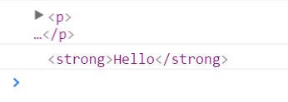
Cascade access
DOM
Select an element from another element:
<p>
<strong>Hello</strong> world!
</p>
<script>
var p = document.querySelector("p");
var strong = p.querySelector("strong");
console.log(p);
console.log(strong);
</script>

Slide 79
DOM Element properties
DOM
Useful properties:
Property | Explanation
textContent | Access to the inner text inside an element
innerHTML | Access to the inner HTML content of an element
classList | Access to CSS classes
Style | Access to CSS style (including classmade)

Slide 80
DOM Element Properties
DOM
Add an element before an other one
<p></p>
var p = document.querySelector("p");
p.textContent = "Hello World";
<p>Hello World</p>

Slide 81
DOM Element Properties
DOM
Add an element before an other one
<p></p>
var p = document.querySelector("p");
p.innerHTML = "<strong>Hello World</strong>";
<p><strong>Hello World</strong></p>

Slide 82
DOM Element Properties
DOM
Add an element before an other one
<p class="otherClass"></p>
var p = document.querySelector("p");
p.classList.add("myClass");
p.classList.remove("otherClass");
<p class="myClass"></p>

Slide 83

DOM Element Properties
DOM
Add an element before an other one
<p>This is a paragraph without style</p>
var p = document.querySelector("p");
p.style.color = "red";
p.style.fontFamily = "Calibri";
p.style.border = "1px blue solid";
p.style.textTransform = "uppercase";
p.style.width = "200px";
p.style.fontWeight = "bold";
Notes:
Note that CSS properties with « - » in them are translated to camelCase.
Ex:
CSS : text-transform
JS : textTransform

Slide 84
Questions ?

Slide 85
Exercise (1/3)
DOM
Update your Guess the number page
We’ll change alert functions to DOM nodes
Part one:
Use prompts to ask user a value
Create paragraphs and append them to the page instead of displaying alerts

Slide 86
Exercise (2/3)
DOM
Update your Guess the number page
We’ll change alert functions to DOM nodes
Part two (use style property of your elements):
« greater » word should be set in green
« lower » word should be set in red
Both words should be bold

Slide 87
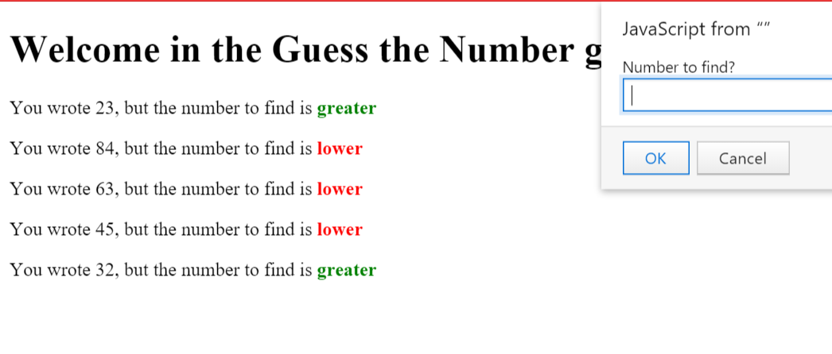
Exercise (3/3)
DOM
Example rendering:

Slide 88

Events
Discover JavaScript language

Slide 89
Presentation
Events
When occurs:
User interaction
Action in the execution context
Properties of objects that depends on them
May call functions

Slide 90
Standard Event Attributes
Events
Attach an event on client click
Old way to do it: Bad practice!
HTML tag
that possesses events
Available event of the object
object
event
<input type="button" value="push me" onclick="alert('you click the button');"/>
Arguments
action
Available arguments of the object
Action associated to the event

Slide 91
Standard Event Attributes
Events
Attach an event on client click
New way to do it: Good practice!
<input type="button" id="myButton" value="Push me!" />
var button = document.querySelector("#myButton");
button.addEventListener("onclick", function() {
alert("You clicked the button!");
});

Slide 92
Standard Event Attributes
Events
Event | Description
DOMContentLoaded | Page’s DOM is built (CSS, JS & Images aren’t loaded yet)
load | Element is fully loaded
unload | Browser leaves current page
click | User clicks on an element
dblclick | User double clicks on an element
mouseover | Mouse flies over an element
mouseout | Mouse leaves an element

Slide 93
Standard Event Attributes
Events
Event | Description
focus | An input field gets focus
blur | An input field loses focus
change | User modifies content of an input field
select | User selects content of an input field
submit | User submits a form

Slide 94
Questions ?

Slide 95
Exercise One
DOM
You’re going to add JavaScript code to your contact form to validate user inputs!
Create a new JS file.
Declare a function named validateForm() which validate your form inputs
All fields have to be filled
If a field has an error, set his color to red
Execute the function on form submit!

Slide 96
Exercise Two (1/2)
Events
You’re going to play with event handler!
Create a page containing only one HTML button
Create a new JS file
With two functions inside:
goToGoogle(): redirect the user to the google website
moveButton(): move the button inside the window without outpassing page bounds

Slide 97
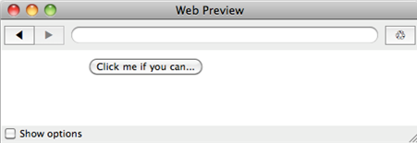
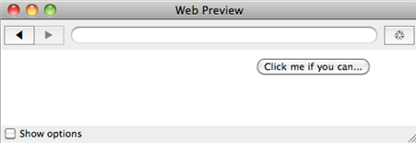
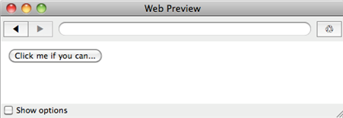
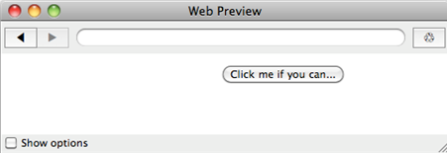
Exercise Two (2/2)
Events

Slide 98
Callback Concept
Discover JavaScript language

Slide 99
What are callbacks?
Callback Concept
Everything that calls a function passed as parameter
It’s a design model, not a language feature.
Look again at this code:
var button = document.querySelector("#myButton");
button.addEventListener("onclick", function() {
alert("You clicked the button!");
});

Slide 100
What are callbacks?
Callback Concept
In this example, you might understand that:
You have the targetted element (button)
You specify that, in case of a click event…
You’ll do that function
var button = document.querySelector("#myButton");
button.addEventListener("onclick", function() {
alert("You clicked the button!");
});

Slide 101
What are callbacks?
Callback Concept
This callback pattern is everywhere in JavaScript
Look this another example:
The inner anonymous function is called for every element
In the next slide, find a possible rewrite of forEach
var myArray = ["Apple", "Strawberry"];
myArray.forEach( function(element) {
console.log(element + "/");
});

Slide 102
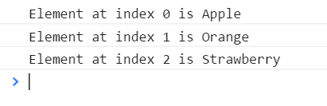
Example of forEach rewrite
Callback Concept
function forEach(array, callback) { // Contains the function
for(var i = 0; i < array.length; i++) {
callback(i, array[i]); // Execute the function
}
}
var fruits = ["Apple", "Orange", "Strawberry"];
forEach(fruits, function(index, value) {
console.log("Element at index "
+ index + " is " + value);
});

Slide 103
What are callbacks?
Callback Concept
Remember that functions can be stored in JS
forEach(fruits, function(index, value) {
console.log("Element at index " + index + " is " + value);
});
Is equal to
var callback = function(index, value) {
console.log("Element at index " + index + " is " + value);
};
forEach(fruits, callback);

Slide 104
Why callbacks?
Callback Concept
Callbacks are useful to:
Override a logic
By default, nothing happens when you click on a HTML element. addEventListener allows you to create your own logic with callback. Same for forEach.
Do something when something else is done
After an asynchronous call or after a delay, you want to do a specific action. JavaScript use callbacks for that.

Slide 105
SetTimeout
Callback Concept
Allows to delay an action after some time
Count in milliseconds (ms)
Uses callbacks
Which alert will be displayed first? Why?
setTimeout(function() {
alert("Hello");
}, 1000); // 1000ms = 1 second
alert("world");

Slide 106
SetInterval
Callback Concept
Allows to do an action periodically
Count in milliseconds (ms)
Uses callbacks
setInterval(function() {
alert("Hello");
}, 1000);
// Displays Hello every second, which is quite annoying

Slide 107
Clear Timeout & Interval
Callback Concept
ClearTimeout:
Allows to remove a setTimeout function
ClearInterval: Same logic
var timeoutID = setTimeout(function() {
alert("Hello");
}, 1000);
clearTimeout(timeoutID); // Won’t display the alert

Slide 108
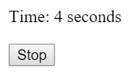
<p>Time: <span>0</span> seconds</p>
<button>Stop</button>
<script>
var span = document.querySelector("span");
var button = document.querySelector("button");
var intervalID = setInterval(function() {
var seconds = parseInt(span.textContent);
span.textContent = ++seconds;
}, 1000);
button.addEventListener("click", function() {
clearInterval(intervalID);
});
</script>
ClearInterval example

Slide 109
Questions ?

Slide 110
Exercise (1/3)
Callback Concept
We’ll do a simple game
Goal: Click on five buttons in less that four seconds
Create a new web page with:
A call to the setTimeout function
Will display « You lost » after four seconds
Notes:
* Deactivate a button:
document.querySelector("button").setAttribute("disabled", true);

Slide 111
Exercise (2/3)
Callback Concept
Five buttons
All buttons with the text « Click me »
Use a loop to assign events
Click on a button will:
deactivate it*
Call the checkStatus function described below
Notes:
* Deactivate a button:
document.querySelector("button").setAttribute("disabled", true);

Slide 112
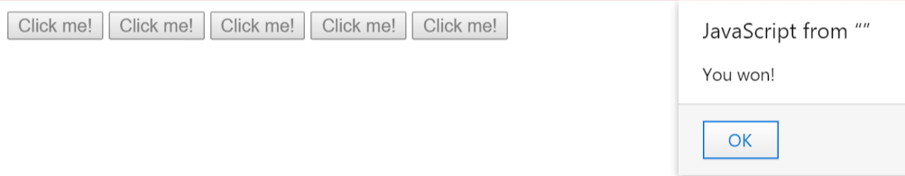
Exercise (3/3)
Callback Concept
A function checkStatus
Will get the « disabled » attribute on every button
If every button is disabled:
Display a « You won » alert
Clear the timeout of the « You lost » alert »
Notes:
* Deactivate a button:
document.querySelector("button").setAttribute("disabled", true);

Slide 113

Introduction to object modeling
Discover JavaScript language

Slide 114
Presentation
Introduction to object modeling
JavaScript is an Object Oriented Programming language that uses Prototypes
We’ll see more about OOP next year but there are some basic concepts we have to see during this course…

Slide 115
Presentation
Introduction to object modeling
Objects in JavaScript are mutable keyed collections
number, string, boolean, null and undefined are primitive types
Arrays are objects

Slide 116
Presentation
Introduction to object modeling
An object contains properties
A property has a name and a value
A property name can be any string
A property value can be any JavaScript value
Strings
Arrays
Functions!

Slide 117
Presentation
Introduction to object modeling
There are several ways to declare an object
We’re going to see just one during this course!
That’s called : Object Literals

Slide 118
Object Literals
Introduction to object modeling
Convenient notation for creating new objects
A pair of curly braces surrounding zero or more name/value pairs:
var barney = {
"firstName": "Barney",
"lastName": "Stinson",
"saySmthg": function() {
console.log("It’s gonna be...");
}
}

Slide 119
Object Literals
Introduction to object modeling
Quotes around property names are optional if the name is a legal JavaScript name
Property values can be other object literals

Slide 120
Object Literals
Introduction to object modeling
Examples:
var barney = {
firstName: "Barney",
lastName: "Stinson",
saySmthg: function() {
console.log
("It’s gonna be...");
}
}
var trip = {
departure: {
city: "Paris",
country: "France"
},
arrival: {
city: "Montreal",
country: "Canada"
},
price: 890
}

Slide 121
Object Literals
Introduction to object modeling
To access a property:
To call a method:
var firstName = barney.firstName;
var lastName = barney["lastName"];
barney.saySmthg();
barney["saySmthg"]();

Slide 122

Object Literals
Introduction to object modeling
To create new instances based on an existing object, you can clone it:
var anotherBarney = Object.create(barney);
anotherBarney.saySmthg = function() {
console.log("... Legendary!");
};
barney.saySmthg();
anotherBarney.saySmthg();

Slide 123
The new operator
Introduction to object modeling
You can also in some specific case use the new operator to create new instances
We’ll see more about how to define objects with it in a next course…
var anArray = new Array(); // It works!
var newBarney = new barney(); // It doesn’t work because
// barney is an object literal

Slide 124
Standard objects
Introduction to object modeling
Main objects provided by the language:
Type | Description
Array | Represent a data array
Math | Provide mathematics functions
Date | Represent a date
RegExp | A useful type to use regular expressions

Slide 125
Standard objects: Math
Introduction to object modeling
Math object
Properties: mathematical constants
Methods: mathematical functions
var nqpi = Math.round(Math.PI); // 3
var logE = Math.log(Math.E); // 1
var al = Math.random(); // Random float between 0 and 1
var al2 = Math.floor(Math.random() * 10);

Slide 126
Standard objects: Date
Introduction to object modeling
Date object
Represents a date/hour
Provide some useful functions
var now = new Date(); // today
var unix = new Date(0); // 1970-01-01
var date1 = new Date("Day Mth dd YYYY hh:mm:ss");
var date2 = new Date("YYYY","MM","DD","hh","mm","ss","ms");
var timestamp = Date.now();

Slide 127
Standard objects: RegExp
Introduction to object modeling
RegExp object
Allow to manipulate regular expressions
Can be created by two ways
Use modifiers:
"g" for "global"
"i" for "insensitive"
var regex = /PATTERN/<g|i|gi>;
regex = new RegExp("PATTERN",<"g"|"i"|"gi">);

Slide 128
Standard objects: RegExp
Introduction to object modeling
RegExp object:
Patterns also have functions:
test(str) to check if there is a match
exec(str) to return matched string parts
var str = "cdbBdbsbz”;
var re = /d(b+)(d)/ig;
var match = re.test(str);
console.log(match); // Display: « true »
var result = re.exec(str);
console.log(result.toString()); // Display: « dbBd,bB,d »

Slide 129
Questions ?

Slide 130
Exercise
Introduction to Object Modeling
Let’s create a Calculator!
Create an HTML file with a sample structure
Add to it a <div> tag with class « calculator »
Create a « style.css » file and link it to the HTML
Create a « script.js » file and link it to the HTML
Notes:
Goal of this exercise is to create a minimal but shippable calculator, not a small and buggy copy of anything existant on the internet.
You have several hours to do this exercise, take your time to display it nicely.

Slide 131
Exercise
Introduction to Object Modeling
In the JavaScript file:
Create a variable Calculator with in it:
A property currentSign
A property number1
A property number2
var Calculator = {
currentSign: false,
...
};

Slide 132
Exercise
Introduction to Object Modeling
Add in the App variable a init(selector) function:
Will query the selector passed in parameter
For each element targetted, will:
Draw in JavaScript a <table> tag
The first row will display the result (colspan 3) and +
The second row will display 7, 8, 9 and -
The third row will display 4, 5, 6, *
The fourth row will display 1, 2, 3, /
The fifth row cill display 0 (colspan 3) and =
Use the generateCell function described after to do that

Slide 133
Exercise
Introduction to Object Modeling
About this table construction...
Copy/pasting a lot of document.createElement() isn’t a really good idea
Create a function generateCell(text, colspan) in your App variable which should:
Create a td element
Set its textContent
If colspan is defined, specify the cell colspan
Return the created element

Slide 134
Exercise
Introduction to Object Modeling
Use your generateCell(text, colspan) function to populate your <table>
init: function() {
...
var row1 = document.createElement("tr");
row1.appendChild(App.generateCell(0, 3));
row1.appendChild(App.generateCell("+"));
table.appendChild(row1);
...
}

Slide 135
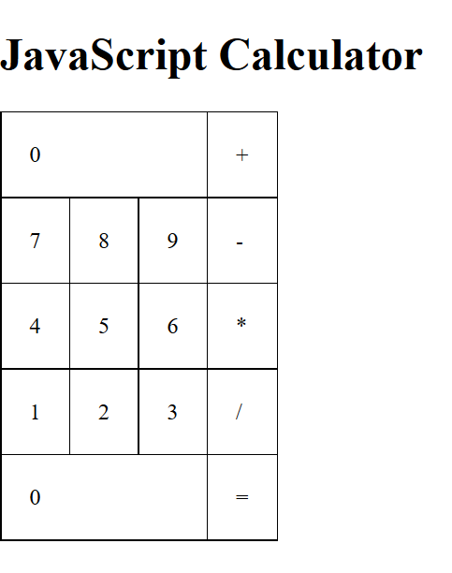
Exercise – Example rendering
Introduction to Object Modeling
/*
This is an example
Feel free to change it
*/
.calculator table,
.calculator td {
border: 1px black solid;
border-collapse: collapse;
}
.calculator td {
padding: 20px;
}

Slide 136
Exercise
Introduction to Object Modeling
Update your generateCell(text, colspan) function
Create a switch structure based on text
Add an event on operators (+, -, *, /)
Should set the currentSign property (+, -, *, /) on click
Add an event on numbers
Should set number1 and number2
See more information in comments
Add an event on the equal sign
Should call a App.compute() function (we’ll define it next)
switch(sign) {
case "+":
case "-":
case "*":
case "/":
break;
case "0":
...
break;
}
Notes:
Notice the default behavior of a calculator.
When you first click on a number, it sets the number1 property (ex 6)
If you click on a second number, it appends it to the number1 property (ex 1 -> makes 61)
For this, you need to set number1 as (the previous number1 * 10) + (the number you just entered)
Another thing, when you click on an operator, the number you type after belong to our number2 property
You need to check in this event if the App.currentSign is set. If not, do the math explained above. If so, do the same math, but store it in number2.

Slide 137
Exercise
Introduction to Object Modeling
Still inside App variable, add a function compute()
Should compute the result between number1 & number2
Do another switch case here on App.currentSign
To know which operator you’re doing ☺
Add a function updateResult(result)
Should target the result cell of your calculator
And set its textContent with the provided result

Slide 138
Exercise
Introduction to Object Modeling
In your compute() function:
Call updateResult(result)
Set back number2 to 0
Set back currentSign to false
Update your event on operators
If a number2 is set, call the compute() function
Else, keep it as is, should still update the sign

Slide 139
Exercise
Introduction to Object Modeling
Last thing to do in the JavaScript:
Handle division by zero ☺
Do an alert
Set back number1, number2 and currentSign to initial
Update your CSS & make your calc beautiful

Slide 140
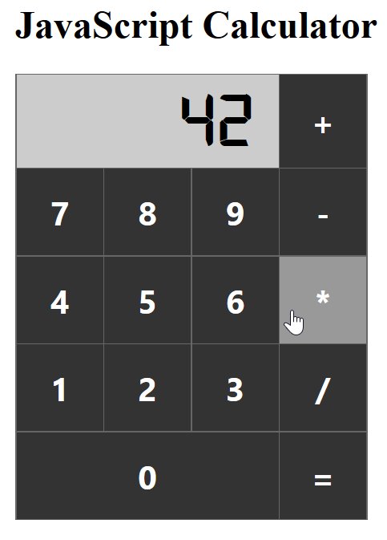
Exercise
Introduction to Object Modeling
Example rendering:

Slide 141
Exercise - Bonuses
Introduction to Object Modeling
Explanation in comments:
Allow your App to create several calculators on the same web page
Add a cell « . » and handle float numbers
Add event on body to handle keyboard input
Notes:
Allow your App to create several calculators on the same web page
Instead of storing one number1, one number2 and one currentSign, you need to store an array of these.
Create a property instances this way: var instances = [ { number1: 0, number2: 0, currentSign: false }, { … }, { … } ]
Figure out how to know which instance you want to modify (and edit it accordingly each time you click on a button)
Add a cell « . » and handle float numbers
Basically this button should add some kind of flag in your App, and if this flag is set you need to count backwards
Check on your operating system calculator (or any other calculator) to understand how it’s built.
Add event on body to handle keyboard input
You need to add an event listener on body tag to handle keyboard input, such as keypress, keyup or keydown.
See this link for more: https://developer.mozilla.org/en-US/docs/Web/API/KeyboardEvent

Slide 142


